Slide 1
Methyl Acetate Manufacture
Progress Report #3
Team T - Abdul Fayeed, Adarsh Kannan, Gavin Guerrera
April 21st, 2022

Slide 2
Overview: Topics to be Discussed
H-mordenite catalyst chosen over ion exchange resin
Background for carbonylation
Offline reactor design model for both types of catalysts
Economic analysis for catalyst costing
Block flow diagram (BFD) for H-mordenite and ion exchange resin
BOE sizing and economic results for both scenarios
Transfer price analysis for both catalysts
Issues related to recycling of CO
Conclusions

Slide 3
Background: Carbonylation
This is a two step process: Dehydration of MeOH, and Carbonylation of DME.
Reaction 1: 2 MeOH DME + H₂O (side reaction in esterification)
Can be catalyzed by Ion-Exchange Resin/H-Mordenite
Reaction 2: DME + CO MeOAc
Catalyzed by Acidic Zeolites H-mordenite
Potential Side Reaction: H₂ + DME CH₄ + MeOAc

Slide 4
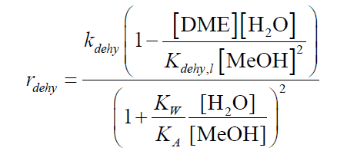
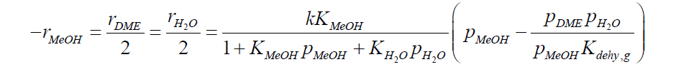
Background: Carbonylation (Rate Expression)
2 MeOH DME + H₂O
Ion-exchange resin catalyst
H-mordenite catalyst

Slide 5
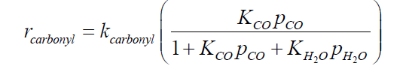
Background: Carbonylation (Rate Expression)
DME + CO MeOAc
H-mordenite catalyst

Slide 6
Offline Reactor Design
Based on the rate expressions and rate law provided, offline reactor models were simulated on MATLAB to estimate the catalyst mass required for the reactor.
Ideal temperatures and pressures were picked for a set conversion.
Reactor sizing done by calculating tube length, diameter and number of tubes.
Model then was tested on ASPEN and optimized.

Slide 7
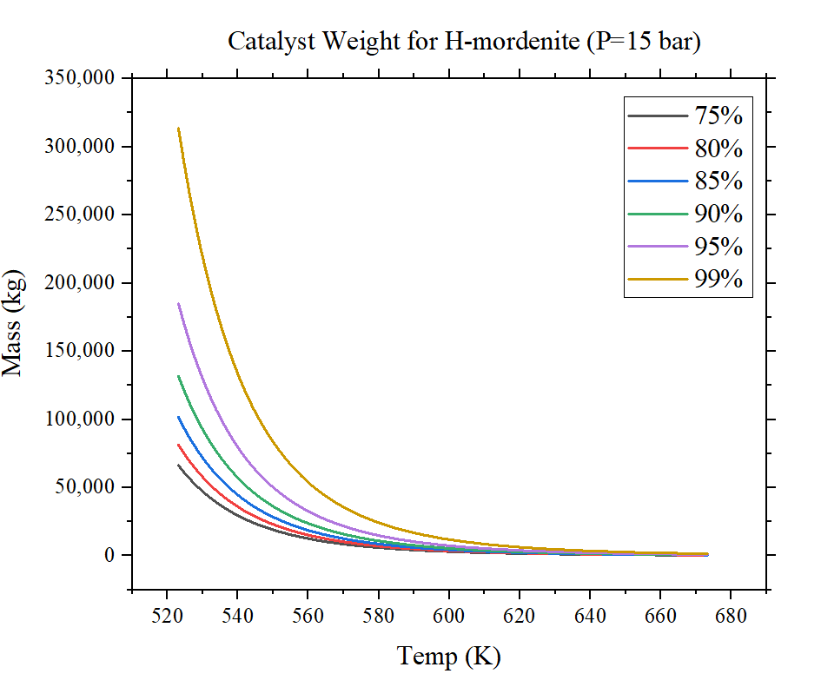
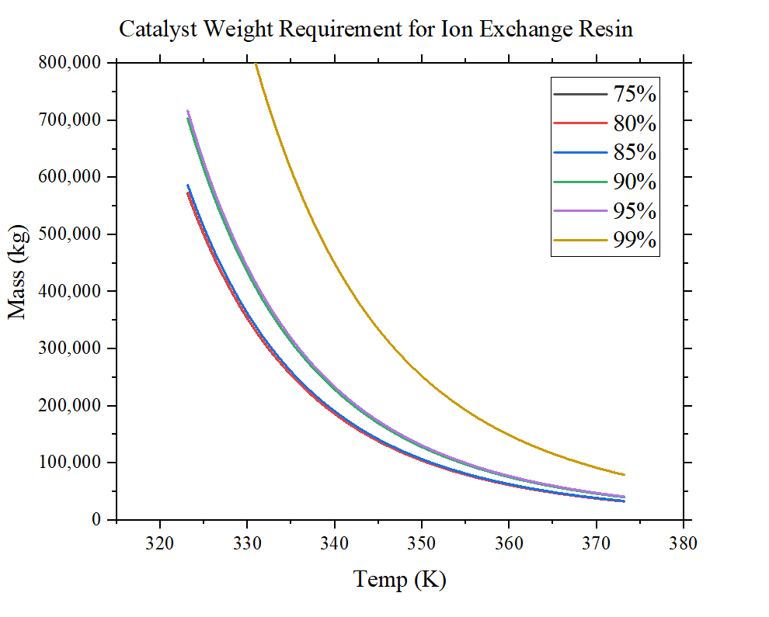
Offline Reactor Design- Catalyst Mass Analysis

Slide 8
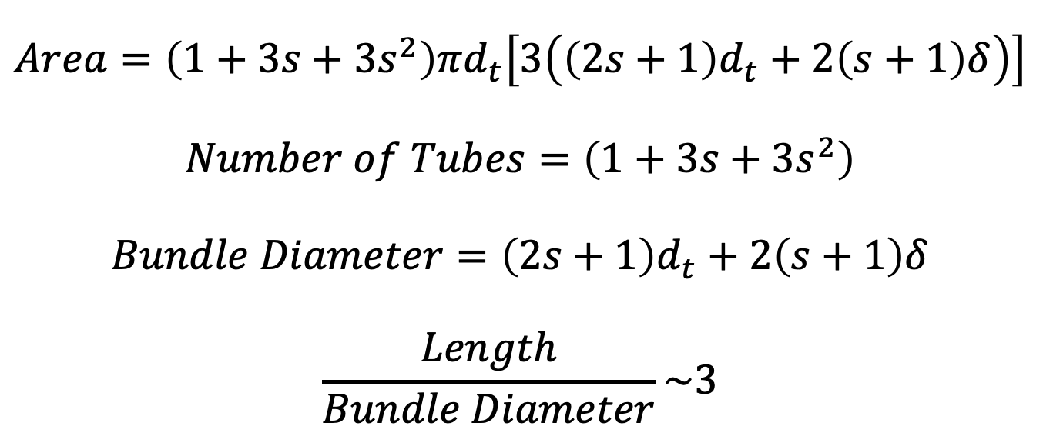
Offline/Online Reactor Design Equations

Slide 9
Ion-Exchange Resin vs. H-Mordenite Catalyst
Ion-Exchange Resin |  | H-Mordenite
Catalyst Mass (kg) | 68,000 | Catalyst Mass (kg) | 2,200
Total Catalyst Cost ($) | 333,176 | Total Catalyst Cost ($) | 154,420
Reactor Cost ($MM/yr) | 8.10 | Reactor Cost ($MM/yr) | 0.24

Slide 10
Final Reactor Design Specs on ASPEN
Reactor Type- Isothermal
Bulk density- 610 kg/m^{3.}(H-mordenite)
Type of reactor | Dehydration | Carbonylation
Catalyst Mass (kg) | 2,200 | 60,000
Number of Tubes | 1,850 | 15,400
Tube diameter (m) | 0.0254 | 0.0254
Tube length (m) | 5.64 | 16.38
Operating Temperature (ºC) | 380 | 209
Operating Pressure (bar) | 24 | 15

Slide 11
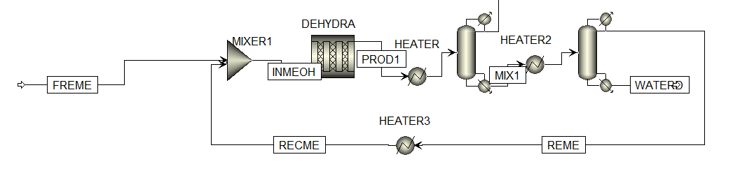
Recycle and Separation Structure for MeOH

Slide 12
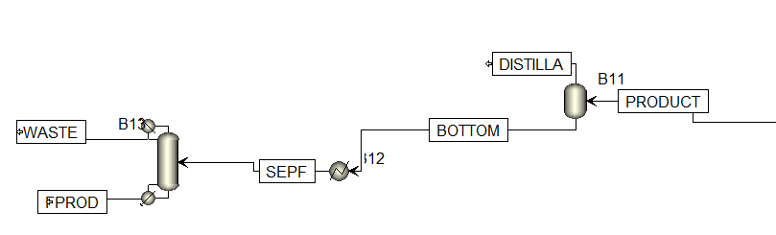
Recycle and Separation Structure for Carbonylation

Slide 13
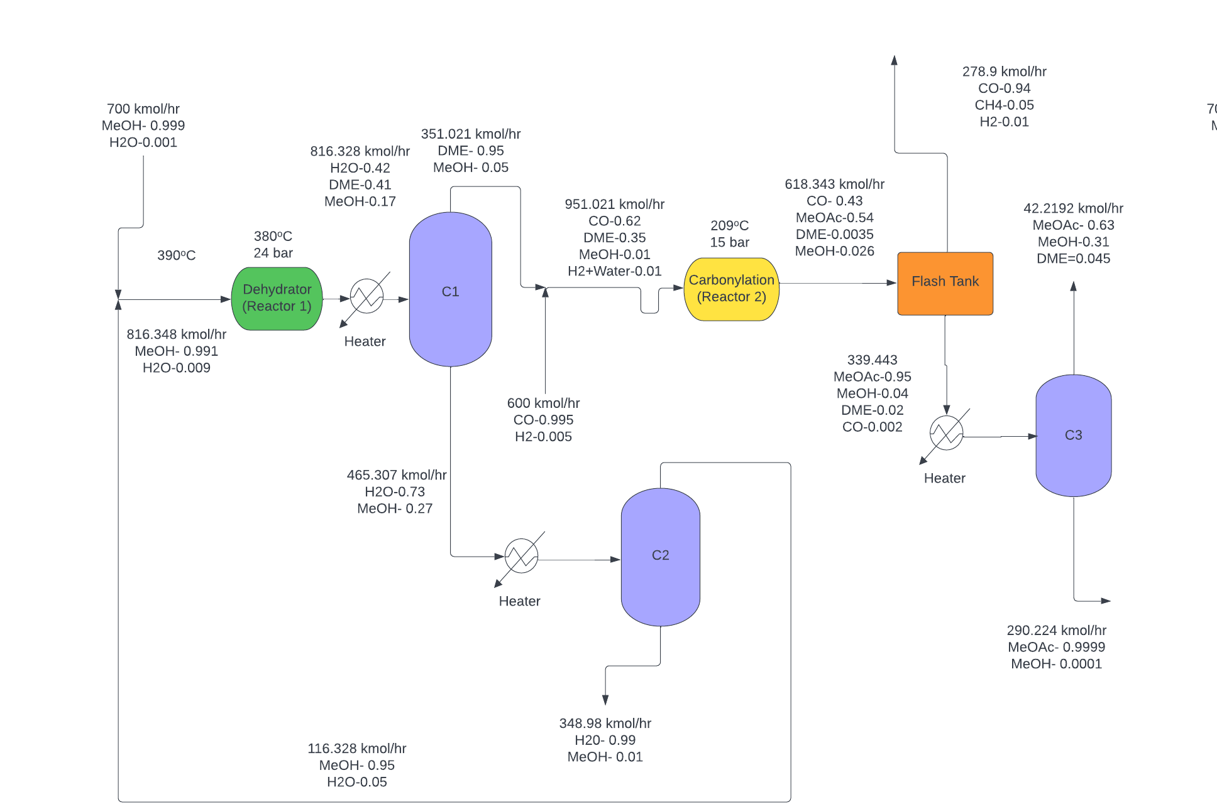
Block Flow Diagram (H-Mordenite)

Slide 14
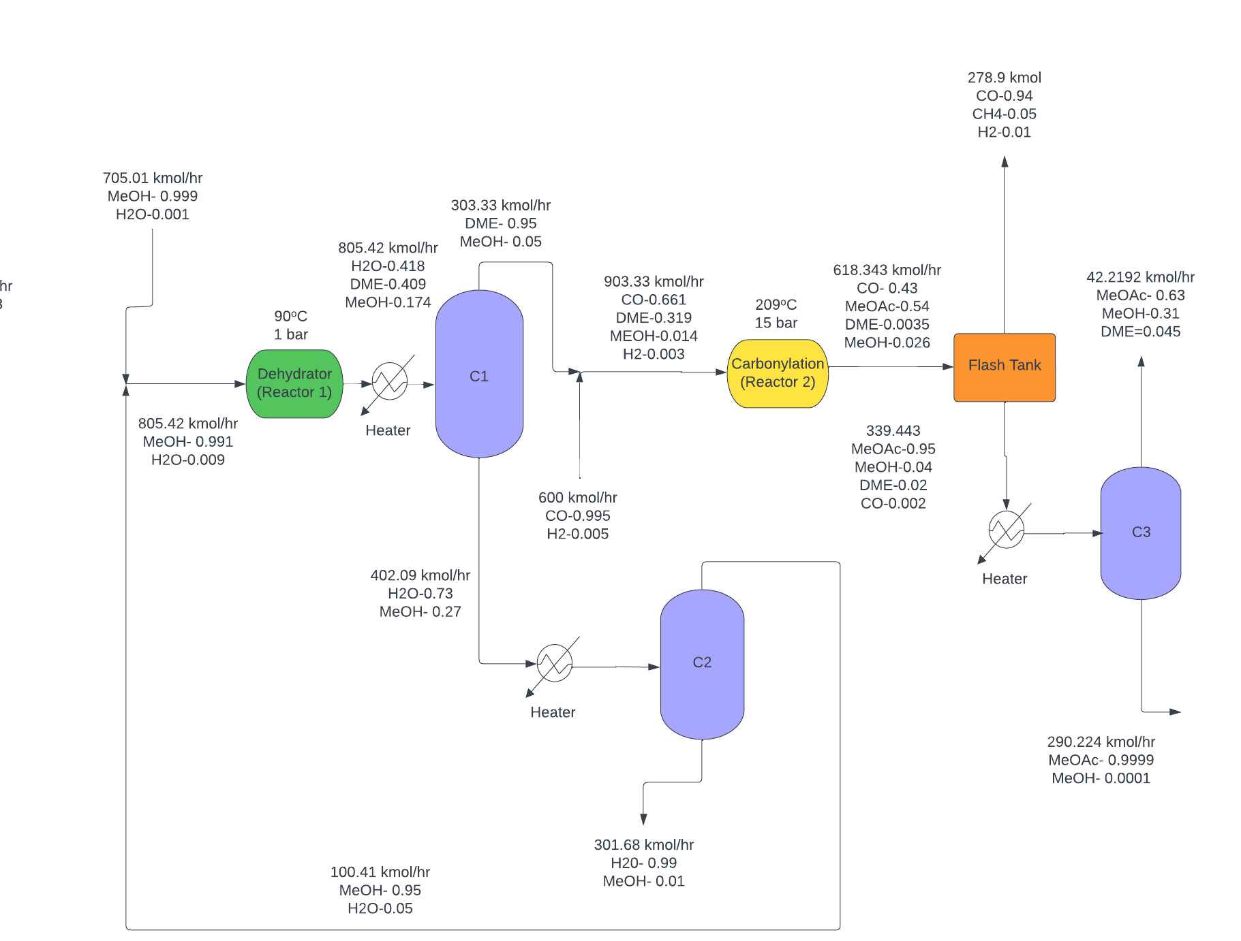
Block Flow Diagram (Ion-Exchange Resin)

Slide 15
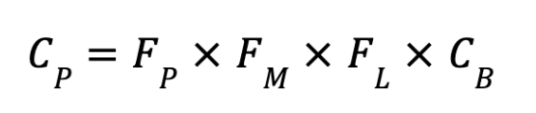
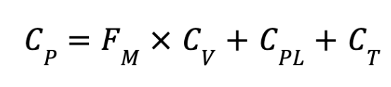

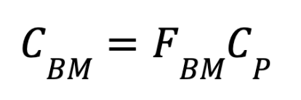
Economics Equations (Purchase Cost C_{P})
Heat exchanger
Distillation column/vertical pressure vessels
Fired heater
Bare-module cost
The following equations were obtained from Seider, Seader, Et Al.

Slide 16
Equipment Costs Comparison
Catalysts | H-mordenite | Ion exchange
Reactor 1 | 0.24 | 8.10
Reactor 2 | 10.29 | 10.29
Reboiler 1 | 0.07 | 0.07
Condenser 1 | 0.08 | 0.07
Reboiler 2 | 0.04 | 0.04
Condenser 2 | 0.04 | 0.04
Reboiler 3 | 0.04 | 0.10
Condenser 3 | 0.06 | 0.03
Flash tank | 0.09 | 0.28
Heater 1 | 1.70 | 0.33
Heater 2 | 0.18 | 0.16
Heater 3 | 0.35 | 0.32
Heater 4 | 1.21 | 0.07
Column 1 | 1.64 | 1.40
Column 2 | 0.96 | 0.86
Column 3 | 0.64 | 0.24
Total C_{BM} | 17.65 | 22.38
($MM/yr)

Slide 17
Revised Economic Analysis
Catalysts | H-mordenite | Ion-exchange resin & H-mordenite
VGA ($MM/yr) | 54 | 67
COM ($MM/yr) | 183 | 198
Transfer Price @ 25% NROI ($/tonnes) | 1,142 | 1,191
IRR (%) | 27.36 | 27.36
NPV ($MM/yr) | 4 | 5
NPC ($MM/yr) | 305 | 317

Slide 18
Conclusions
Large differences in catalyst weights and reactor sizes
H-Mordenite catalyst is favorable choice, due to cost for both catalyst and reactor.
Process needs to optimized further.
Issues with CO separation (Illustrated Next Slide).

Slide 19
Issues with CO separation
Simulation didn’t converge as expected due to the accumulation of methane in the system (produced from the side reaction).
Separation structure to split methane and CO requires cryogenics, and occurs at high pressure and low temperatures.
The cost of adding another separation structure outweighs the cost of additional feed.

